Slide 1
Lean Project Summer 2, 2025 Team: Food Production Student names who worked on this presentation: Name: Cody Clifford Name: Ciana Omnis Name: Hannah Gorospe Name: Anh Le Name: Saloni Tanpure

Slide 2
Part 1: Report on Food Production Industry

Slide 3
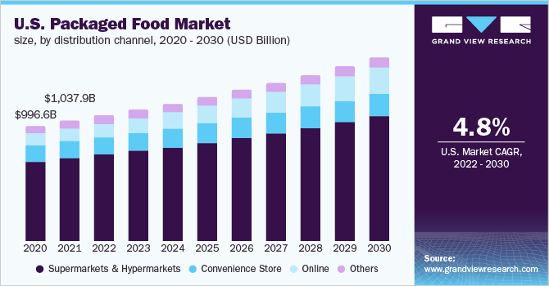
Industry Overview
US packaged food industry is estimated at a value of $1.03 trillion in 2021
Largest companies include Kraft Heinz, Kellanova, and General Mills
Expected to grow by 4.8% annually until 2030, driven by busy schedules and growing preference for convenience
Notes:
Cody

Slide 4
Industry Main Challenges: Last 10 years
Problems
Big companies dominate: small food producers can't compete
Low profits: costs for materials, and labor keep rising, but profits stay small
Supply chain issues: delays and food waste hurt businesses
Goal of improvements
Support small producers: help them get fair access to stores and customers
Boost profits: cut costs with better tools, and stronger supply chain
Cut waste: use better planning, managing and smart tech
Notes:
Anh

Slide 5
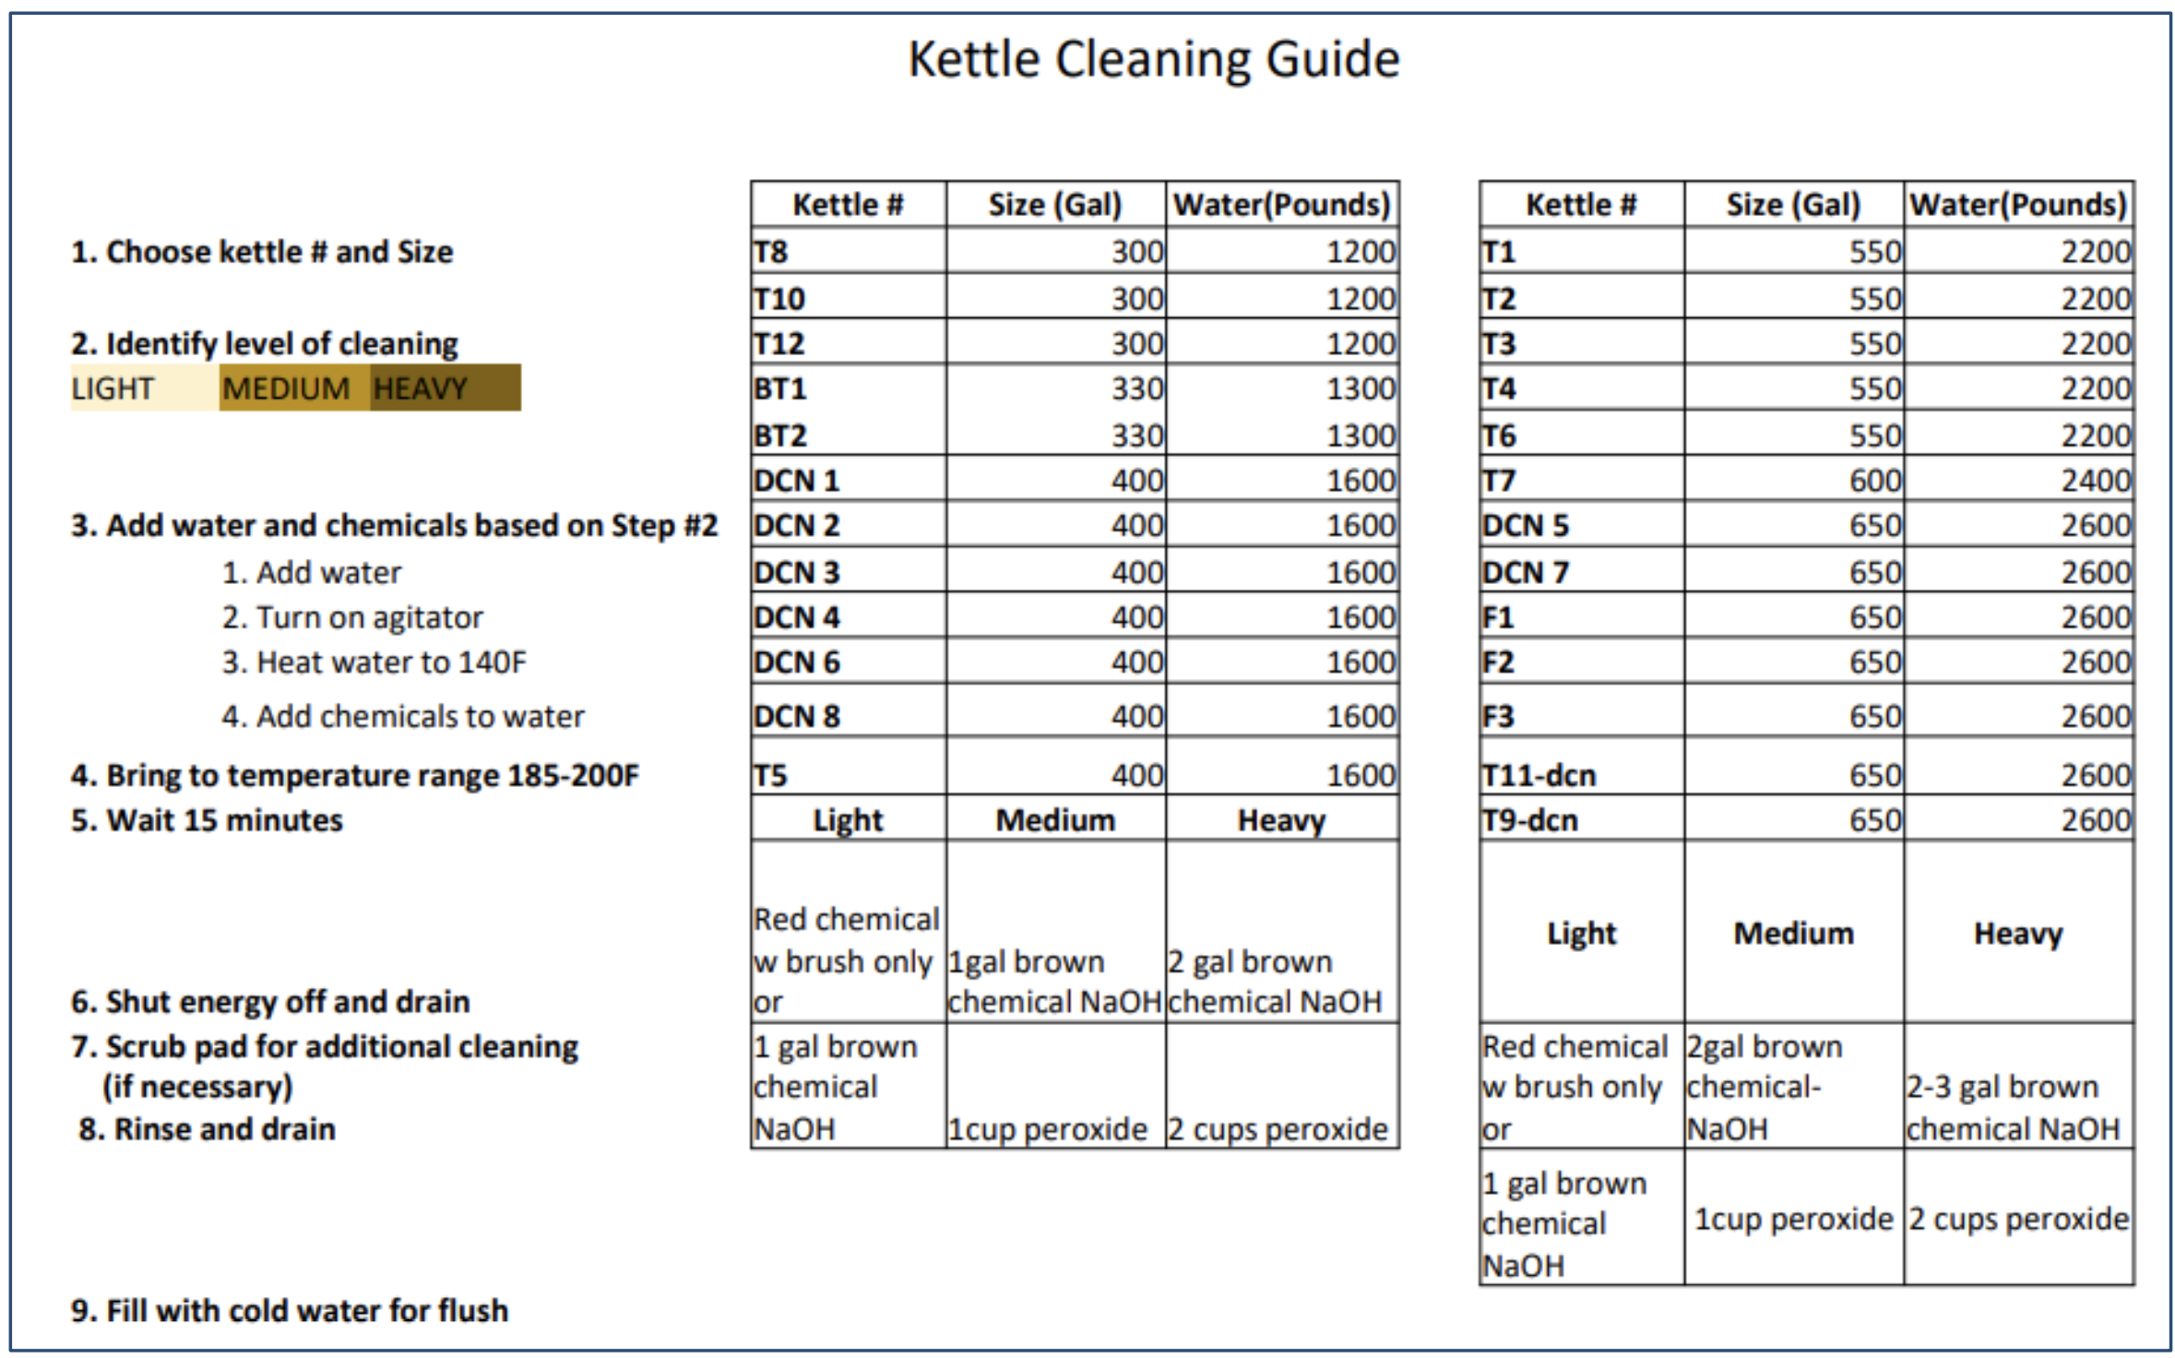
Example of Lean Incentive Accomplished in Last 10 years: Kettle Cuisine
What was done
Implemented SOPs in cleaning
Measurable Results
Production grew 32%, chemical growth limited to 27%
Lessons Learned
Clear processes improve efficiency & reduce waste
Next Steps
Involve operators in efforts, specify level of cleaning
Notes:
Hannah

Slide 6
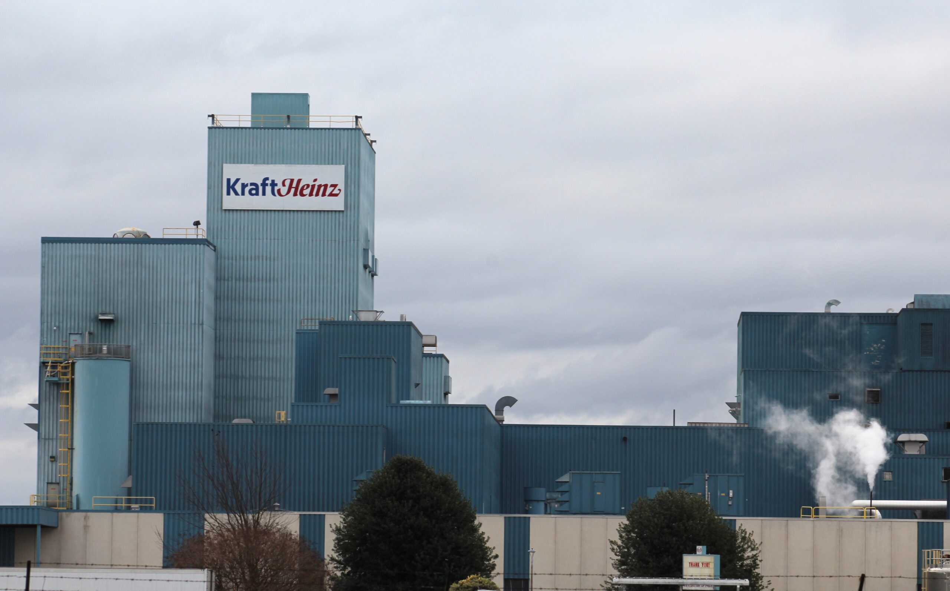
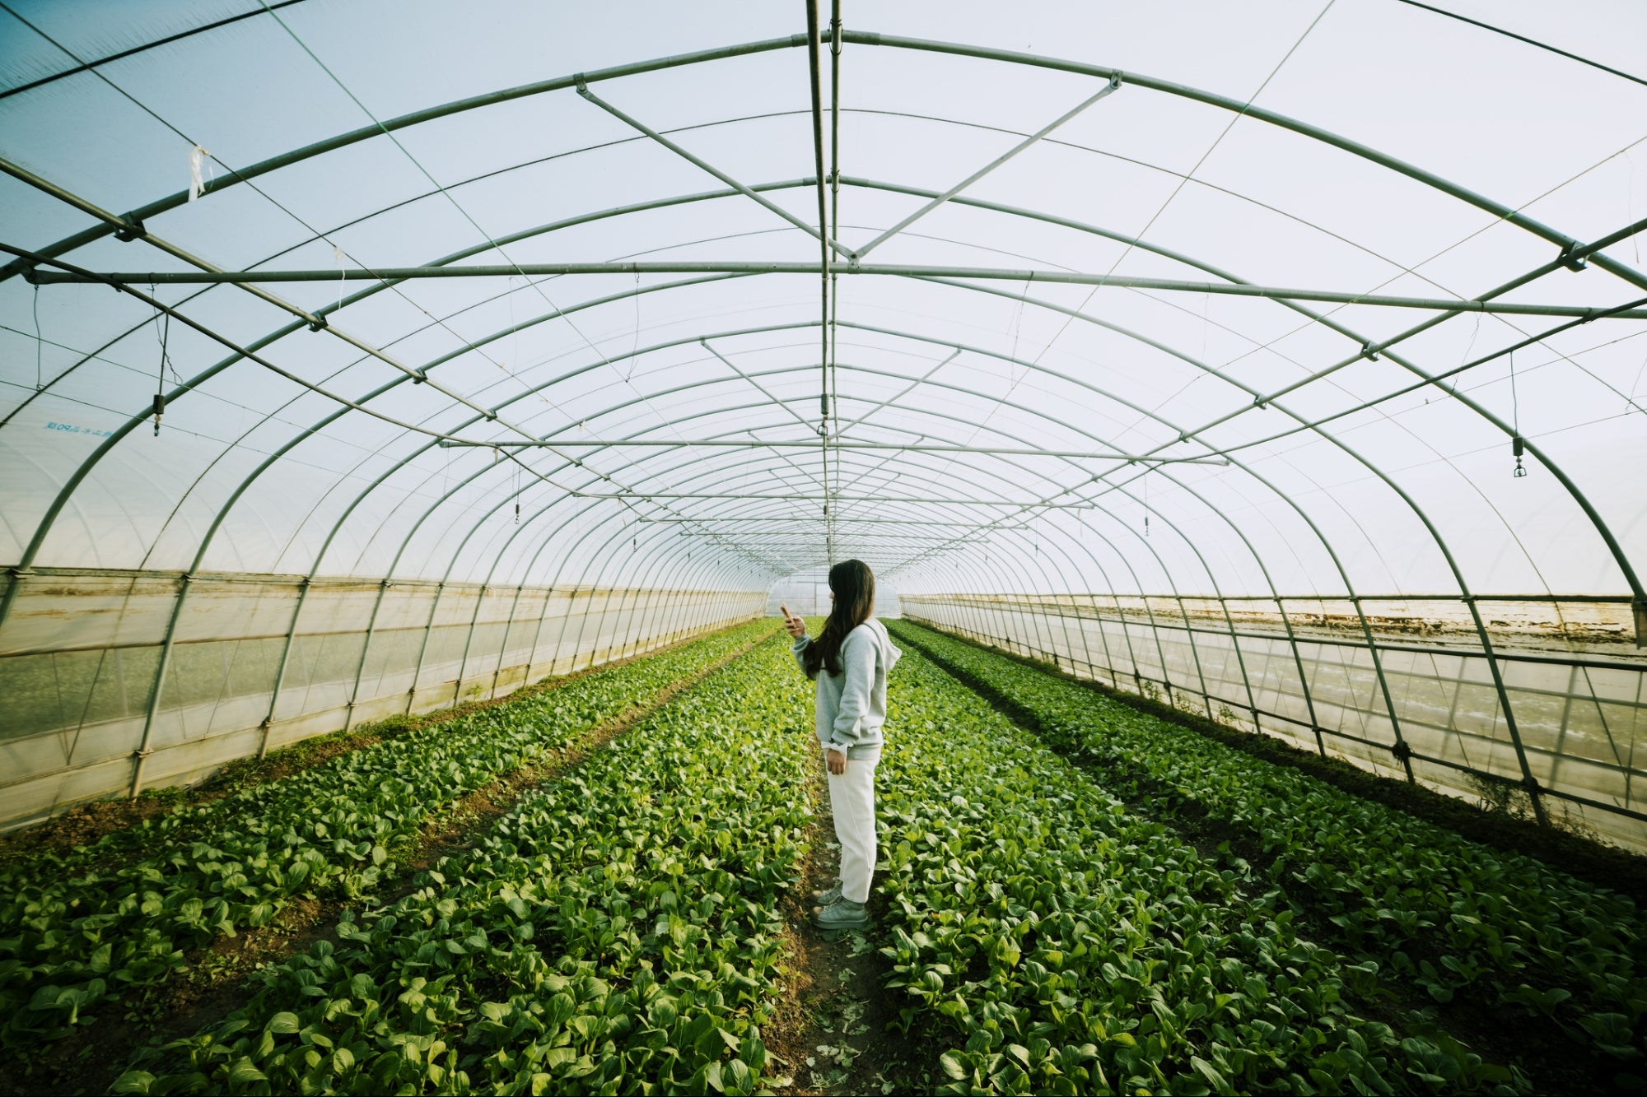
Current Challenges and Areas for Lean Improvement
Hard for small businesses to compete with larger ones, often bought out or shut down
Expenses for materials, labor, energy continue to climb
Supply chain disruptions result in spoilt food and longer storage times
Sustainability initiatives to counter environmental stress require capital to change current practices
Notes:
Anh

Slide 7

Part 2: Proposal for Sweet Babu's

Slide 8
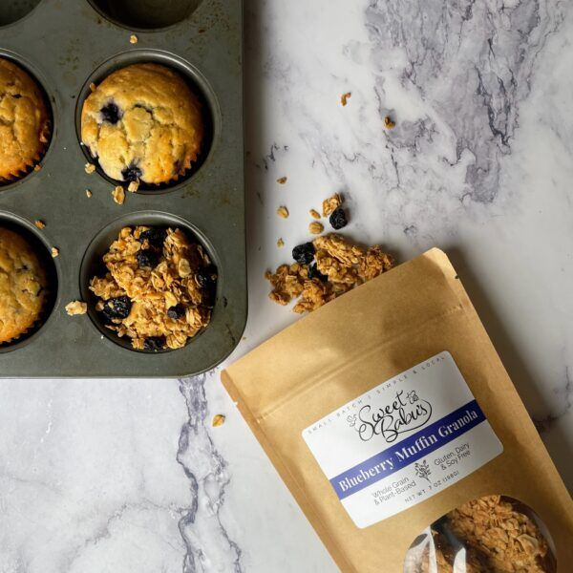
Company Overview
Product
Gluten-free granolas in a variety of flavors (Maple Pecan, Cherry Pie, Blueberry Muffin)
Maple Roasted Nuts as a complementary product
Company Background
Founded by Chelsea, inspired by her grandmother's recipes
Uses mostly local ingredients, except oil
Started in a commercial kitchen in Chicopee, expansion planned
Growth Highlights
150 lbs of granola produced daily
900 lbs/month sold to Springfield school
Sales doubled year-over-year
Working with a small regional distributor
What Makes It Unique
Unique chunky texture and bold flavors
Higher price, but justified by quality
Little competition from big brands due to niche
Notes:
Anh

Slide 9
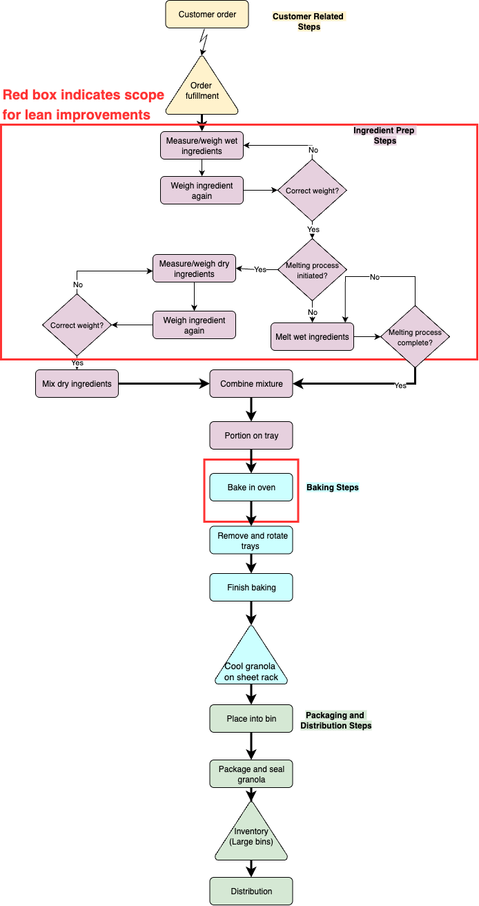
Analysis of Current State
Producing oil mixtures are temperature sensitive and require precision, forming a bottleneck
Ingredients need to be double checked for weight by hand, a non-value-added process
Human errors result in batches requiring rework, being sold at cost to local markets, or being tossed altogether
Partly open oven doors are common issues
Notes:
Cody

Slide 10
Proposed Lean Project: “What”
Solutions
Digital scales with alert systems, checklists to reduce time spent proportioning granola
Additional oil heating and mixing equipment to reduce production time
Adding sensor to oven to warn operators of an open door
Measurable Goals
Cycle times are reduced across the entire granola production process
Oil output for all flavors is increased
Human errors and resultant waste are reduced
Duration
Training for new equipment should be brief, only a few hours per employee
Addition of door sensor to oven may require an electrician’s services, could put oven out of commission for a day
Continuous improvement workshops to refine equipment handling and encourage new lean opportunities may take a few hours, should be continued indefinitely
Notes:
Ciana

Slide 11
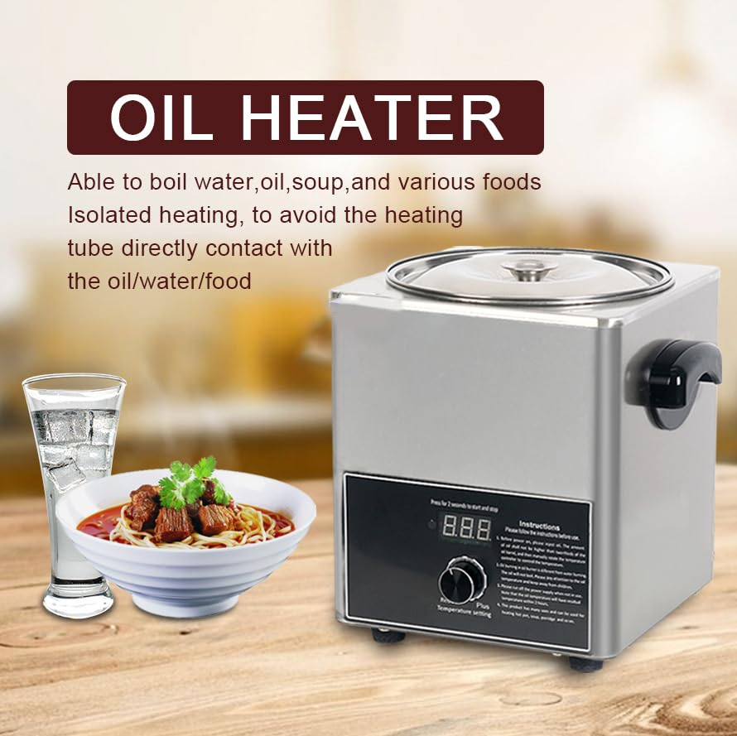
Proposed Lean Project: “How Much”
Budget
Required Resources
Training for new equipment
Electrician for sensor installation
Item | Estimated Cost
Visual Weighing System | $250
Additional Oil Equipment | $200
Weighing/Portioning Tools | $45
Oven Door Poka-Yoke System | $1,200
Training Workshops | $400
TOTAL | $2,095
Notes:
Saloni

Slide 12
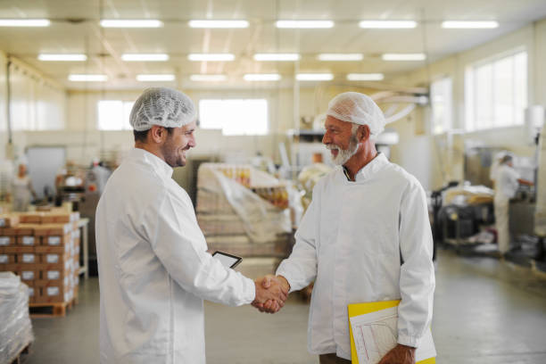

Steps for Continuous Improvement
Record weekly number of batches requiring rework/scrap
Use employee feedback
Kitchen space expansion
Future automation opportunities
Notes:
Hannah

